Slide 1
Google Analytics
Mobile 7
&
Consumer 7

Slide 2
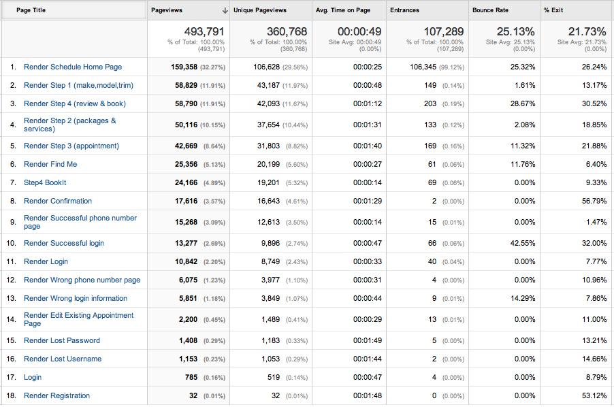
Mobile 7
Data Collected between September 6th-17th

Slide 3
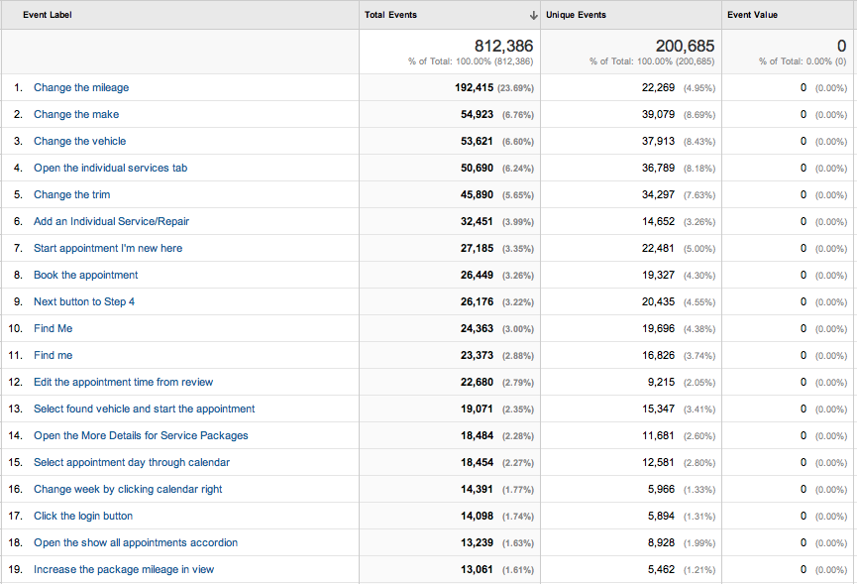

Slide 4
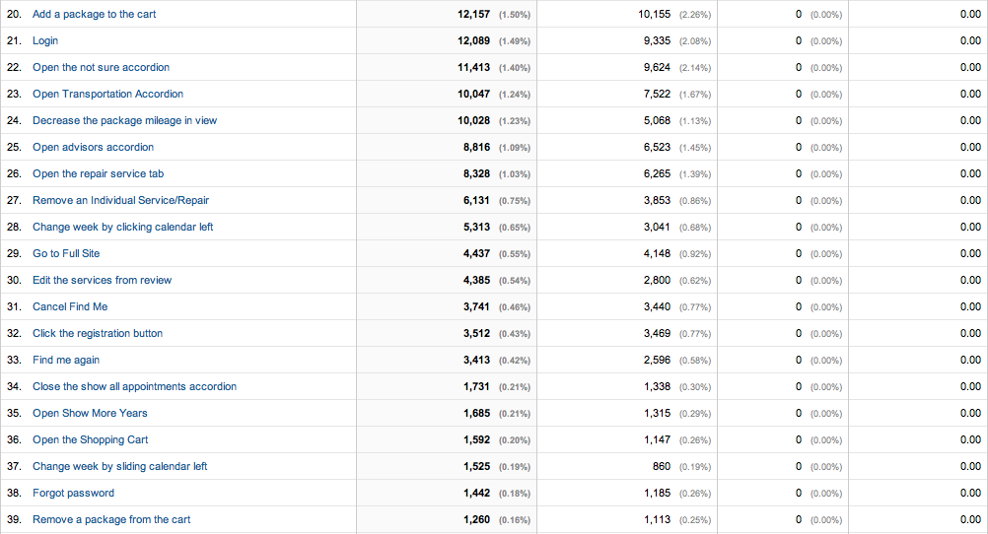

Slide 5
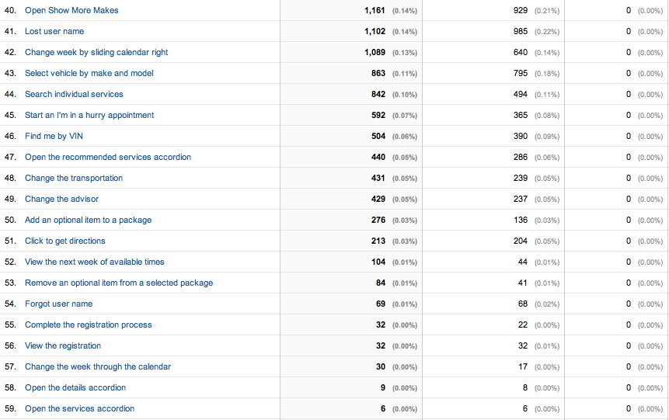

Slide 6
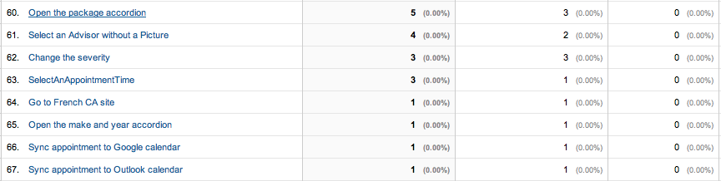

Slide 7
44 Correctly tracked events
15 Correctly tracked pages

Slide 8
Set up goal tracking for conversion rates
Set up ecommerce if interested more in economic value being produced (mobile more ‘trusted’ for lesser costs procedures compared to CP3?)
Still need more data from the events involving user interactions. Important ones like open morning, midday, and afternoon time slots on step 3 as well as the interactions with selection on step 1.
Consider a new page design for just reviewing/confirming of appointment
Confluence page for Mobile 7

Slide 9
Consumer Portal 3
Confluence is up to date on what is being correctly tracked at the moment.
Confluence CP3

Slide 10
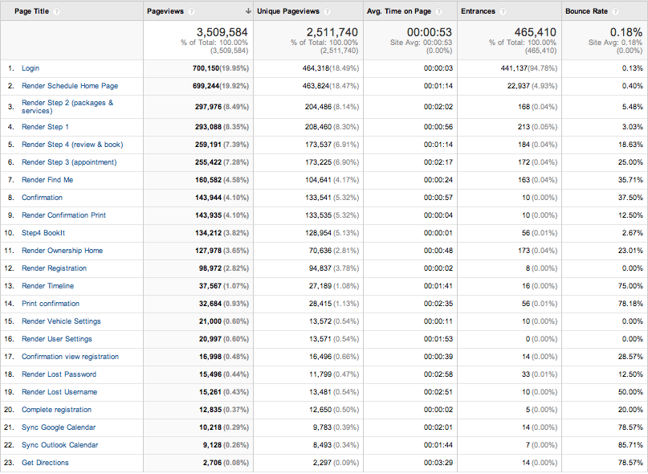

Slide 11
50- edit appointment time and service
Lots of find me
Im in a hurry not popular

